Slide 1
Data preparation and planning
BDK12-1 | Data Annotation and Curation
Nicole Vasilevsky | OHSU Library – Ontology Development Group

Slide 2
The Research Life Cycle
Data Collection
i
v
Data Archiving and/or Sharing
ii
QA/QC
Processing & Analysis
iv
Describe & Document
iii

Slide 3

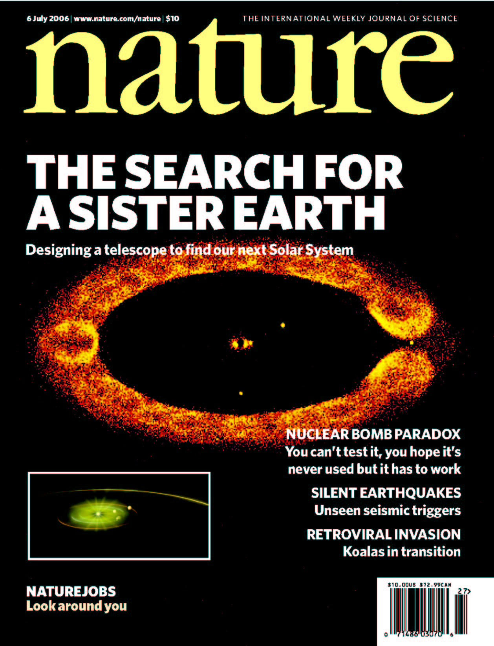


Data files are generated from a lot of sources
Experimental data
School / Work files
Scholarly output
Research resources

Slide 4
Commonly used file types
1
Text docs (such as doc, docx)
2
Spreadsheets (such as xls, xlsx)
3
Image files
4
Audio files
5
Other file types

Slide 5


What tools or software do you need to render the data?

Slide 6
What type of file formats do you use?
Recommended File Format:
Plain text (txt)
HTML
RTF
PDF/A only if layout matters
Avoid for data sharing:
Word (doc, docx)
q Microsoft Word docs (doc, docx)
q Microsoft Excel spreadsheets (xls, xlsx)
q JPG, TIFF files
q MP3
q Other

Slide 7
What type of file formats do you use?
q Microsoft Word docs (doc, docx)
q Microsoft Excel spreadsheets (xls, xlsx)
q JPG, TIFF files
q MP3
q Other
Recommended File Format:
CSV
TSV
SPSS portable
Avoid for data sharing:
Excel (xls, xlsx)

Slide 8
What type of file formats do you use?
q Microsoft Word docs (doc, docx)
q Microsoft Excel spreadsheets (xls, xlsx)
q JPG, TIFF files
q MP3
q Other
Recommended File Format:
TIFF
JPEG2000
PNG
Avoid for data sharing:
GIF
JPEG, JPG

Slide 9
What type of file formats do you use?
q Microsoft Word docs (doc, docx)
q Microsoft Excel spreadsheets (xls, xlsx)
q JPG, TIFF files
q MP3
q Other
Recommended File Format:
Container:
MP4
Ogg
Codec:
Theora
Dirac
FLAC
Avoid for data sharing:
Quicktime
H264

Slide 10
What type of file formats do you use?
q Microsoft Word docs (doc, docx)
q Microsoft Excel spreadsheets (xls, xlsx)
q JPG, TIFF files
q MP3
q Other
Consult your IT department or Library to learn more about best formats for long term preservation

Slide 11
How much data are you producing?
2000%
Billion gigabytes of data
Year 2020
http://www.technologyreview.com/news/514351/has-big-data-made-anonymity-impossible/

Slide 12
What do we call all this data?
1,000 bytes = 1 kB (kilobyte)
1,000 kB = 1 MB (megabyte)
1,000 MB = 1 GB (gigabyte)
1,000 GB = 1 TB (terabyte)
1,000 TB = 1 PB (petabyte)
1,000 PB = 1 EB (exabyte)
1,000 EB = 1 ZB (zettabyte)
1,000 ZB = 1 YB (yottabyte)

Slide 13
How will you store and backup the data?
Computer/Laptop
Network
External devices
Remote/Cloud
Physical storage (eg notebooks)

Slide 14
How will you store and backup the data?
Storage option | The good | The bad
Computer/Laptop | Convenient for active data | Easily lost/stolen Fail Manual backup
Network | Automatic backup and security | Access Capacity limitations
External devices | Low cost Portable Easy to use | Easily lost/stolen Fail
Remote/Cloud | Global access Collaboration | Security/privacy limitations
Physical storage (eg notebooks) | Convenient Tangible | Manual backup

Slide 15
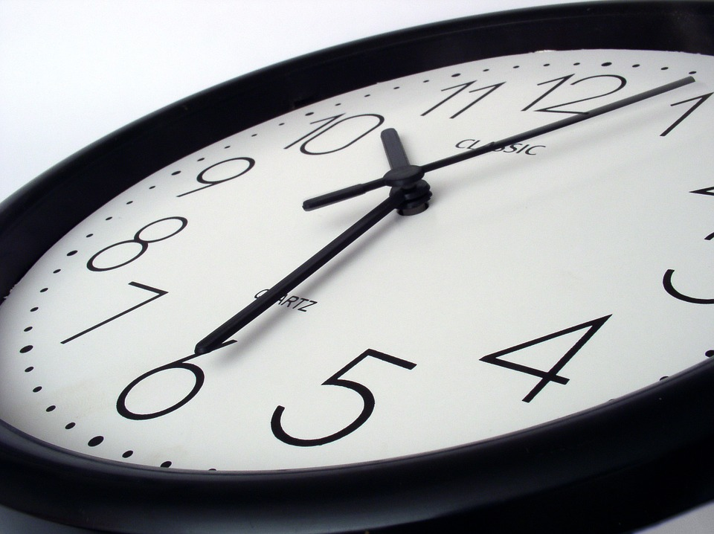
How long will you retain the data?

Slide 16
Thank you
This course was made possible under a grant from the NIH (# 1R25GM114820-01)

